Slide 1

NEXT GENERATION MOBILE
HARDWARE & SOFTWARE
The Future of Smartphones and Intelligent Mobile Computing Systems
First-Year B.Tech IT

Slide 2


EVOLUTION OF MOBILE TECHNOLOGY
The Smartphone Journey
Next-Gen Tech Defined
Smartphones transitioned from basic communication handsets into pocket-sized supercomputers capable of handling gigabytes of real-time data.
Next-generation mobile tech combines micro-level hardware engineering with intelligent software stacks.
>
Hardware Acceleration: On-device Neural Processing Units (NPUs).
>
1G & 2G Era: Voice calls and basic text messaging.
>
3G & 4G Era: Mobile internet, video streaming, and app ecosystems.
>
Contextual OS: Generative AI replacing traditional app menus.
>
5G & Beyond: AI workloads, low latency, edge processing.
>
Seamless Convergence: Inter-device sync across IoT & wearables.

Slide 3







NEXT-GEN HARDWARE PILLARS
Dedicated NPUs
Flexible Displays
Solid-State Batteries
Computational Sensors
Neural Processing Units handle billion-parameter AI models locally with minimal power draw.
Foldable, rollable OLEDs with variable 1-144Hz refresh rates and integrated under-screen sensors.
Silicon-anode and fast-charging tech offering multi-day endurance and enhanced thermal safety.
Multi-spectral camera modules with real-time AI depth mapping and pixel binning.

Slide 4
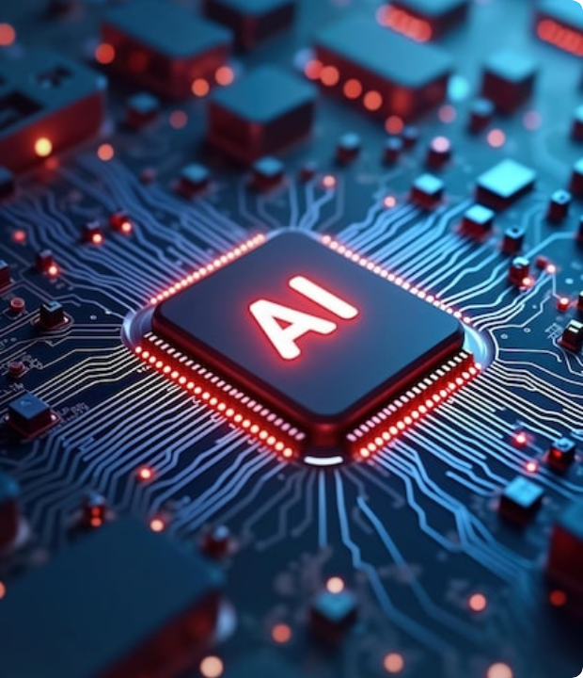
ADVANCED MOBILE PROCESSORS
The Silicon Architecture
Modern System-on-Chips (SoCs) integrate multi-core CPUs, high-throughput GPUs, and specialized NPUs manufactured on 3nm/2nm process nodes.
Key Advantages: Enables instant offline language translation, real-time video generative effects, zero-latency biometrics, and 40% greater power efficiency.

Slide 5

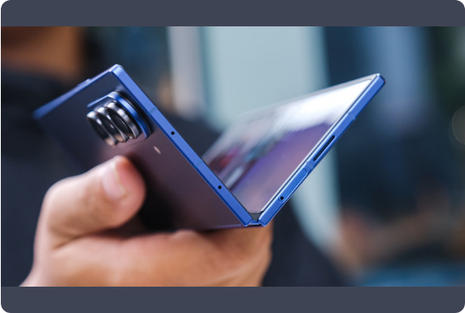
DISPLAYS, CAMERAS & SENSORS
The user-facing hardware of future smartphones focuses on immersive visual fidelity and intelligent environmental perception.
Flexible OLED/Micro-LED: Crease-free foldable and expandable rollable form factors.
Computational Photography: AI multi-frame synthesis overrides optical limits.
3D LiDAR & Biometrics: Sub-millimeter spatial mapping for AR and secure authentication.

Slide 6




FUTURE MOBILE SOFTWARE ECOSYSTEMS
AI-Centric Operating Systems
Zero-Trust Security
Cross-Device Continuity
On-device biometric encryption keys and confidential computing enclaves to safeguard personal data.
Instant unified memory sync across smartphones, smart glasses, laptops, and automotive dashboards.
OS architectures designed around proactive AI agents rather than passive grid-of-icons interfaces.

Slide 7
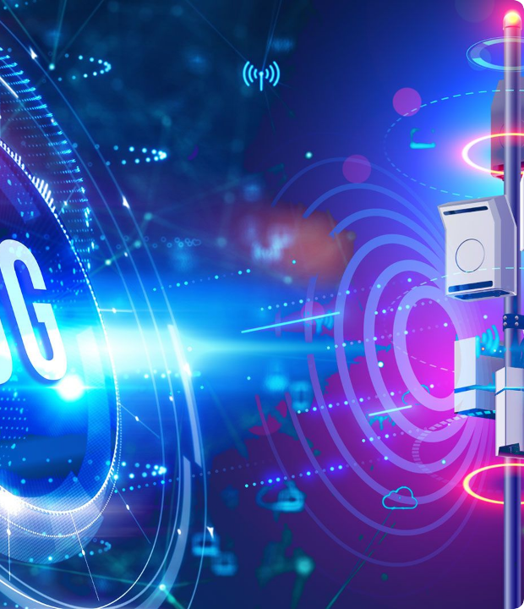
5G ADVANCED & 6G NETWORKS
Hyper-Connected Future
Next-gen connectivity bridges physical and digital spaces via sub-millisecond latencies and terabit-per-second throughput.
Key Capabilities: Direct-to-cell satellite coverage in remote zones, Integrated Sensing and Communication (ISAC), and AI-native radio frequencies.

Slide 8




HARDWARE & SOFTWARE INTEGRATION
2. On-Device OS
4. Adaptive UX
Local AI stack schedules model inference.
Personalized automated assistant action.
1. Silicon Layer
3. Context Engine
SoC + NPU compute raw vector matrix operations.
Sensors supply environmental context.

Slide 9
BENEFITS VS. INDUSTRY CHALLENGES
Domain | Key Benefits | Critical Challenges
Performance & AI | Instant local AI execution, ultra-fast gaming, enhanced privacy. | High thermal throttling, chip production cost, model size limits.
Form Factor | Expandable screens, ultra-thin profiles, durable glass. | Mechanical wear in hinges, battery size constraints, e-waste.
Connectivity | Global satellite link, zero-lag streaming, instant cloud sync. | Infrastructure deployment costs, spectrum congestion, security risks.

Slide 10
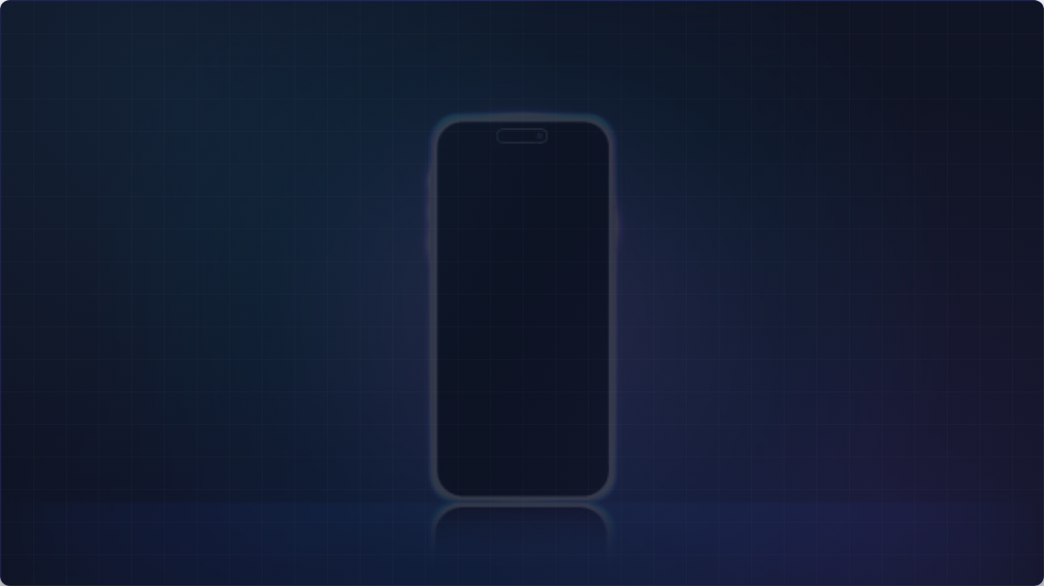

CONCLUSION & SUMMARY
Next-generation mobile hardware and software are converging to redefine the smartphone from a simple communications gadget into an adaptive, autonomous artificial intelligence companion.
"The smartphone of the future will not simply be faster — it will be smarter, more connected, and more adaptive."

Slide 11




IMAGE SOURCES
https://img.magnific.com/premium-photo/ai-chip-circuit-board-advanced-tech-with-glowing-lines-modern-tech-concept-digital-future_1303267-19442.jpg?semt=ais_hybrid&w=740&q=80
Source: www.magnific.com
https://www.bgr.com/img/gallery/7-of-the-best-foldable-phones-according-to-consumer-reports/intro-1783431304.jpg
Source: www.bgr.com
https://www.itu.int/hub/wp-content/uploads/sites/4/2026/03/6G-montage_AdobeStock.jpg.optimal.jpg
Source: www.itu.int
https://media.istockphoto.com/id/2178297785/vector/futuristic-neon-blue-light-smartphone-mockup-glowing-vector-illustration-with-violet-blue.jpg?s=612x612&w=0&k=20&c=ZqXjlwFoEzYpdlwhppbmmn7-gWIGTlfEpDNvK11f-t0=
Source: www.istockphoto.com

